Slide 1

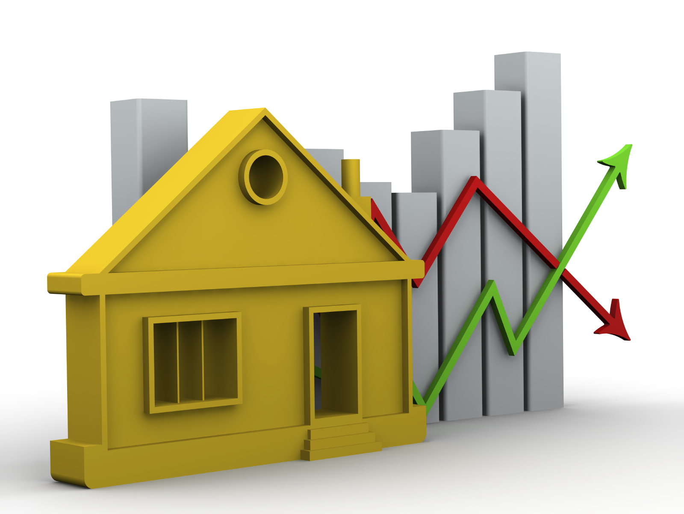
WELCOME TO PROJECT 3
EDA HOUSE PREDICTION AND INSIGHTS
By: Priya Tripathi

Slide 2

Exploratory Data Analysis for Real Estate Pricing
This presentation explores the dynamics of house valuation in a dynamic market. We will delve into the data to identify key variables that influence house prices, uncovering patterns and trends that can inform strategic decisions and enhance business opportunities.

Slide 3
Problem Statement
The Challenge
The Goal
Determining an optimal and competitive price for a house is a multifaceted challenge in the dynamic real estate market.
Conduct a comprehensive analysis to identify and understand the variables that significantly influence house prices.

Slide 4

Situation Overview
The real estate industry is inherently complex, influenced by numerous factors that collectively impact the pricing of residential properties. We will navigate through this complexity and extract meaningful insights from the available data.
The dataset comprises diverse parameters such as location, size, amenities, market trends, economic indicators, and historical transaction data. We will unravel their interdependencies through meticulous analysis.

Slide 5

Exploratory Data Analysis (EDA)
EDA serves as the cornerstone of any data-driven project, playing a pivotal role in unraveling the complex patterns and insights hidden within datasets.
In the context of our real estate pricing project, EDA acts as the compass guiding us through the myriad variables that influence house valuations. By thoroughly examining the dataset through the lens of EDA, we gain a deeper understanding of the underlying dynamics in the real estate market, facilitating informed decision-making and strategic positioning of properties.

Slide 6

Importance of EDA
EDA is indispensable in extracting actionable insights from raw data, especially in domains like real estate where numerous factors contribute to the final property value.
Through EDA, we can identify key variables that significantly impact house prices, allowing us to tailor pricing strategies, enhance customer satisfaction, and gain a competitive edge in the market.

Slide 7
Steps in EDA for Real Estate Pricing
1
Feature Engineering and Size Impact
2
Market Trends and Historical Pricing
3
Customer Preferences and Amenities
Engineer new features capturing relevant information such as price per square foot or the age of the property. Visualize the relationship between key features like bedrooms, bathrooms, and square footage with house prices, determining their impact on valuation.
Analyze historical pricing trends over time, considering external factors like economic indicators. Create time-series visualizations to understand how market trends influence house prices, helping predict future valuation trends.
Explore the influence of customer preferences and amenities on house prices. Utilize sentiment analysis on customer feedback to gauge the perceived value of specific features. Apply clustering algorithms to group houses with similar amenity profiles, revealing distinct market segments and pricing strategies.

Slide 8

Data Loading and Cleaning
The first step in our EDA journey is to load the real estate pricing dataset into a Pandas DataFrame. This allows us to manipulate and analyze the data efficiently.
Next, we will clean the dataset by handling missing values, removing duplicates, and addressing any anomalies. This ensures data quality and accuracy for our analysis.

Slide 9
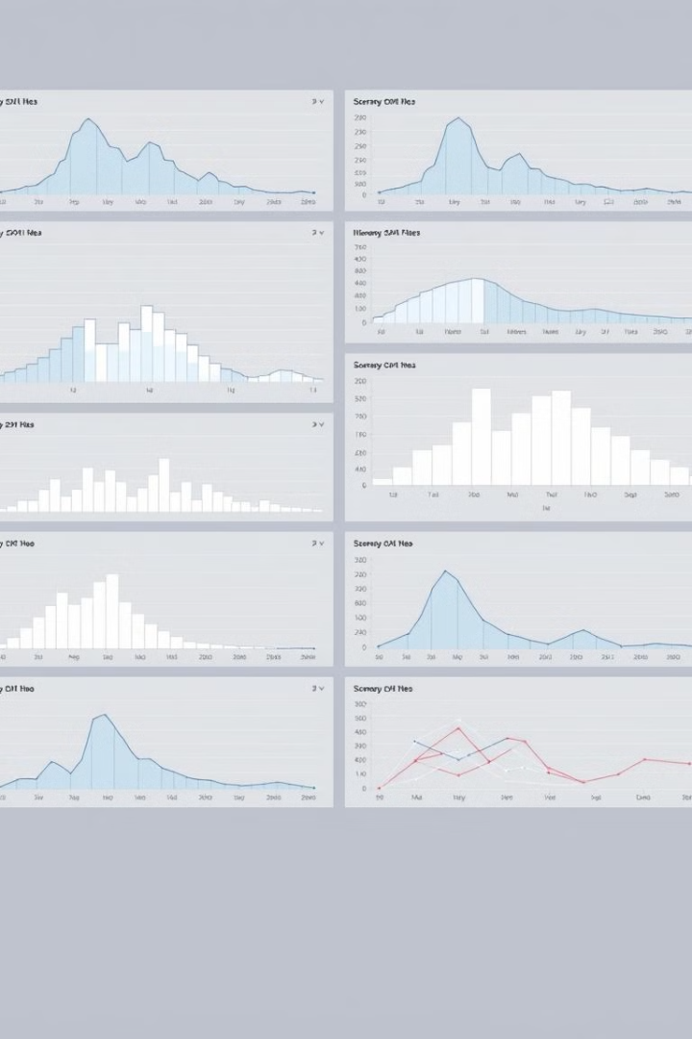
Univariate and Multivariate Analysis
We will conduct a univariate analysis to understand the distribution of key variables like house prices. We will utilize histograms, kernel density plots, or other visualizations to gain insights into the data.
Next, we will perform multivariate analysis to understand the correlations and dependencies between various features. We will utilize techniques like correlation matrices or scatterplot matrices for a comprehensive view.

Slide 10

Feature Engineering and Size Impact
We will further analyze the impact of features and size on house prices. We will explore relationships between key features (e.g., number of bedrooms, bathrooms, square footage) and house prices.
We will identify how these features collectively contribute to the valuation, providing insights into the importance of different aspects of a property.

Slide 11

Market Trends and Customer Preferences
We will explore historical pricing trends over time and understand market influences. We will analyze the dataset temporally, looking at trends in house prices over different periods.
We will also investigate how customer preferences and amenities impact house prices. We will examine the dataset to understand how specific amenities (e.g., swimming pool, garage) impact house prices. We will analyze customer feedback or reviews to gauge the perceived value of these amenities.

Slide 12


